Slide 1
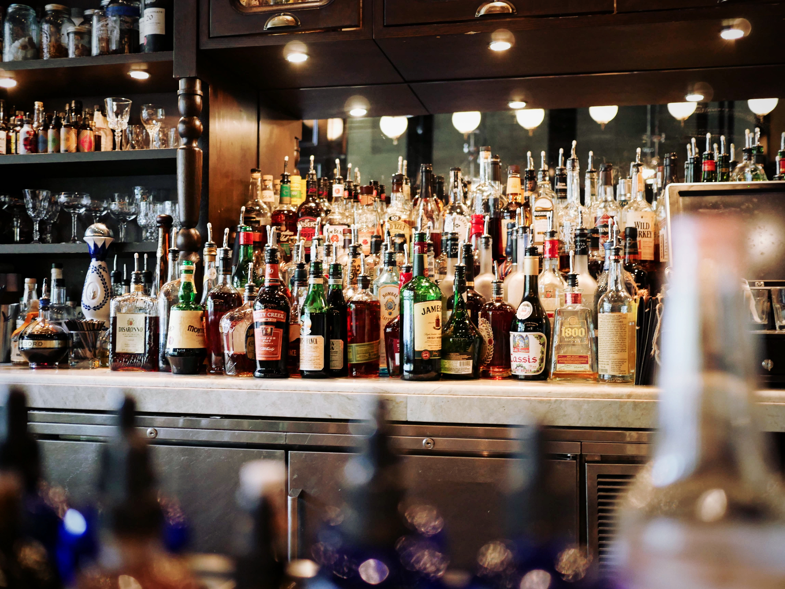
COORS COMPETITION ASSESSMENT
Ori, Niko, Carson, & Srinivasa

Slide 2
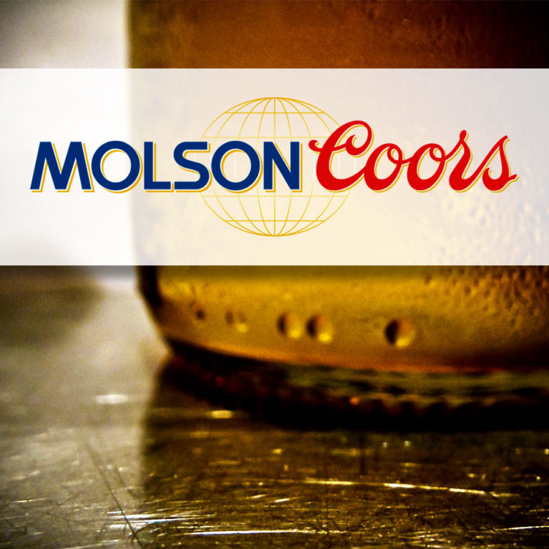
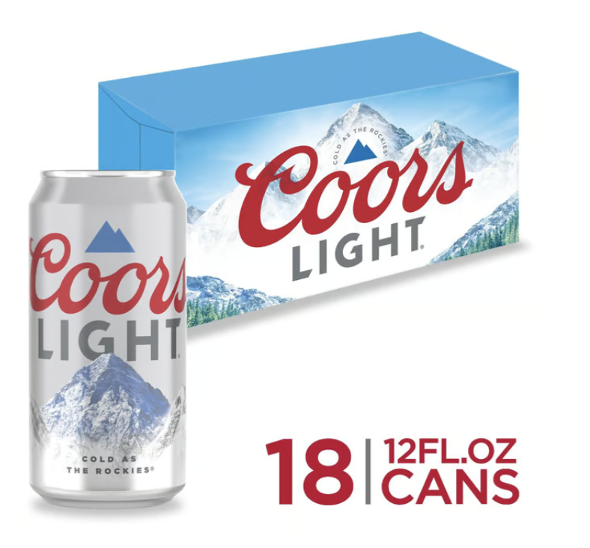
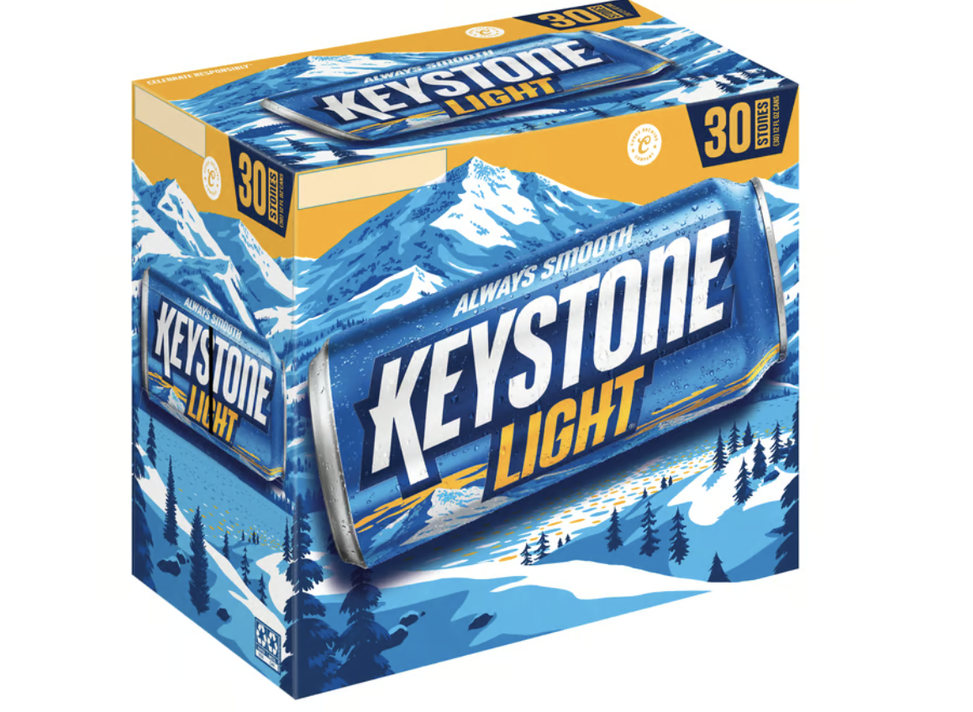
MOLSON BRANDS
Coors Light:
4.6 star rating based on 20+ reviews.
Keystone Light: 4.7 star rating based on 35 reviews.

Slide 3
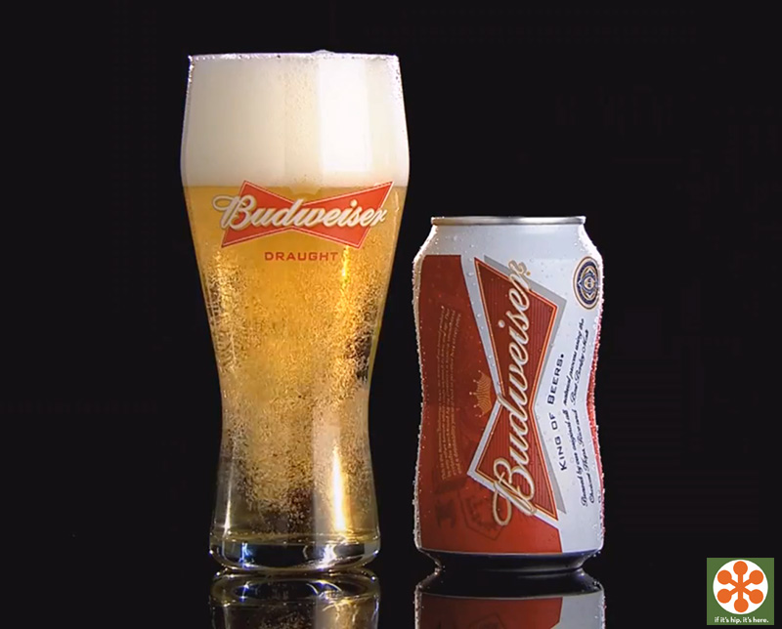
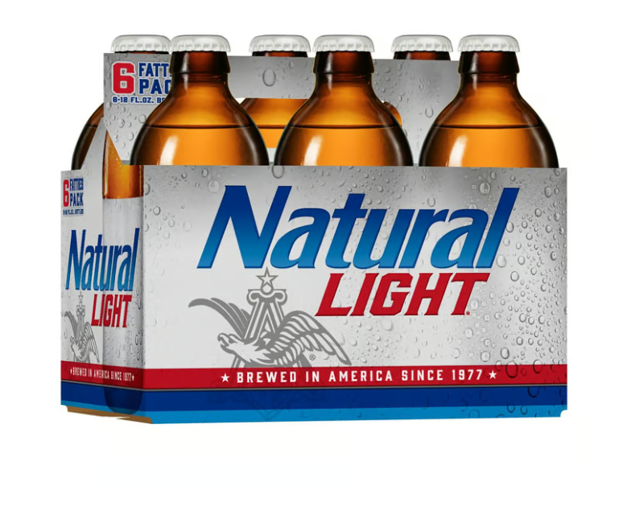
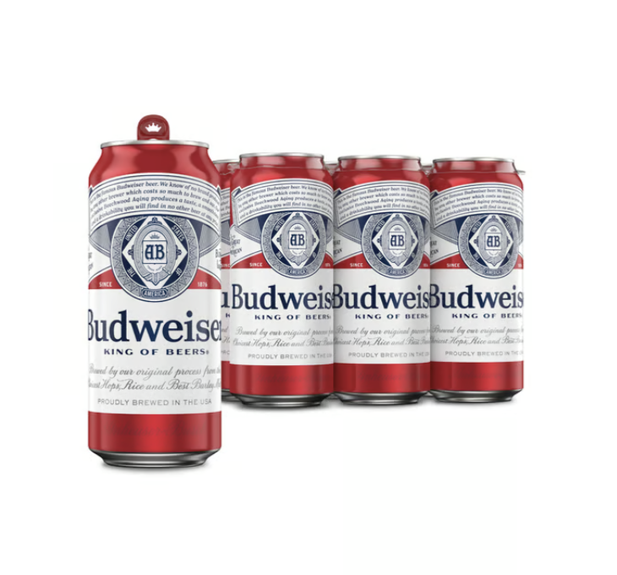
ANHEUSER BUSCH BRANDS
Natural Light:
4.8 star rating based on 28 reviews.
Budweiser:
4.8 star rating based on 60 reviews.

Slide 4
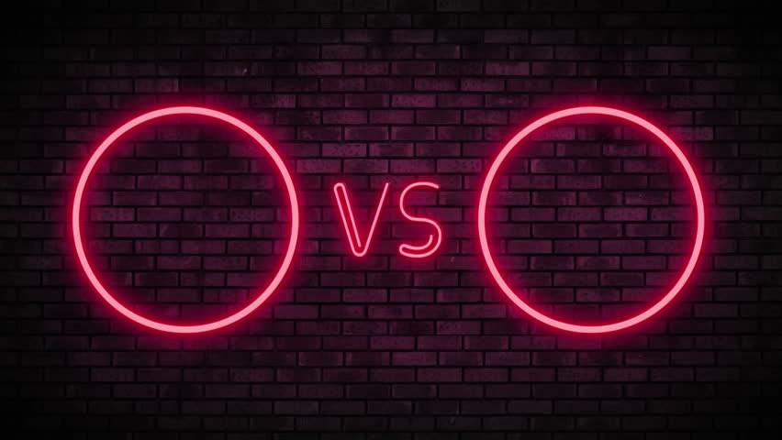
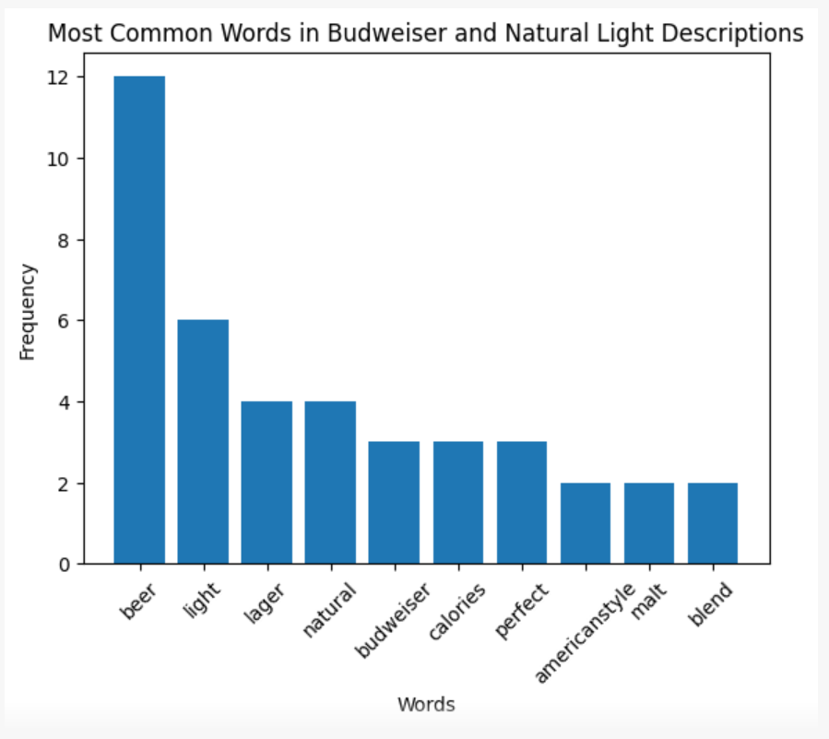
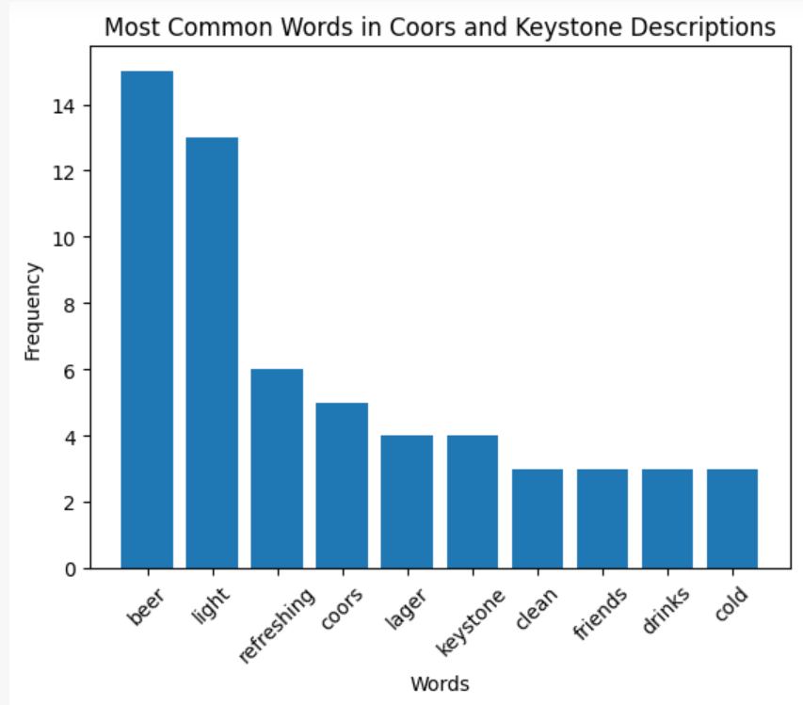
DESCRIPTION COMPARISON BETWEEN ANHEUSER BUSCH AND MOLSON BRANDS

Slide 5
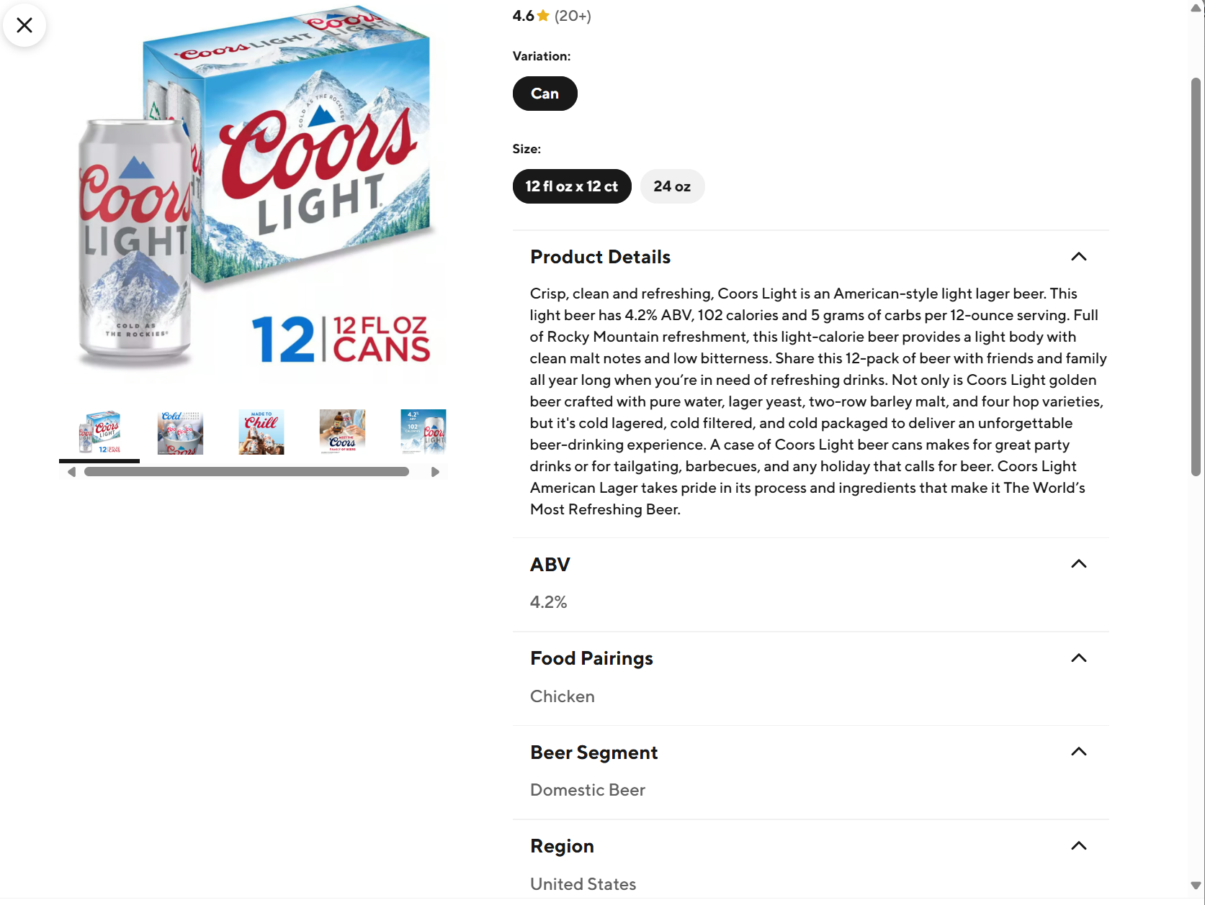
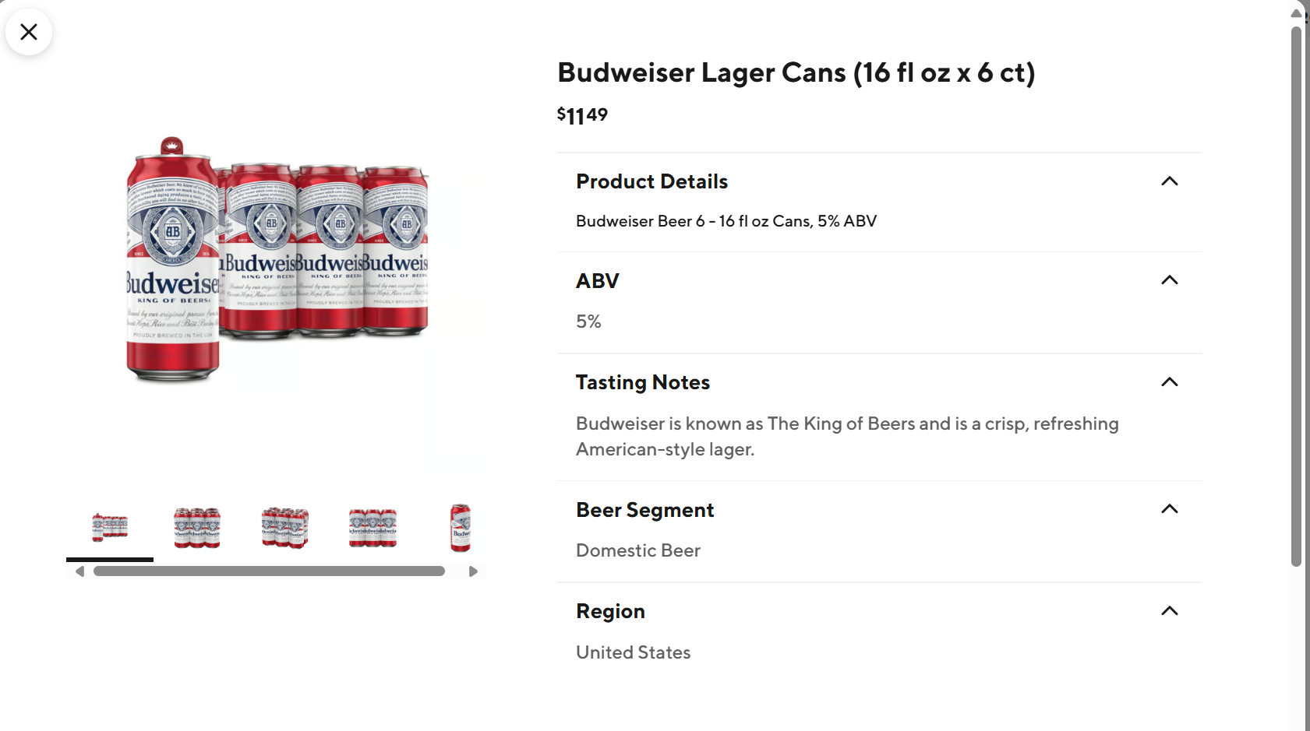
COORS LIGHT VS BUDWEISER ON DOORDASH

Slide 6
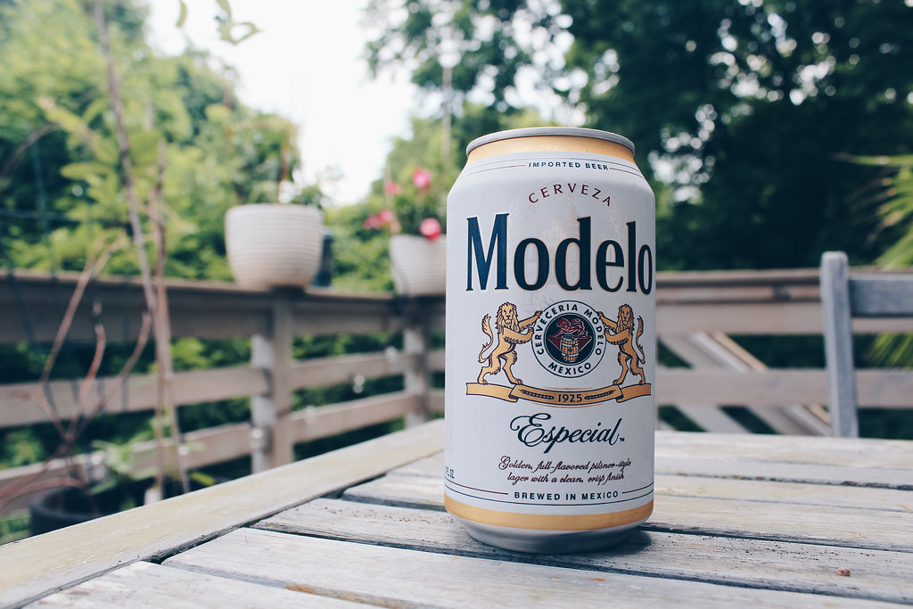
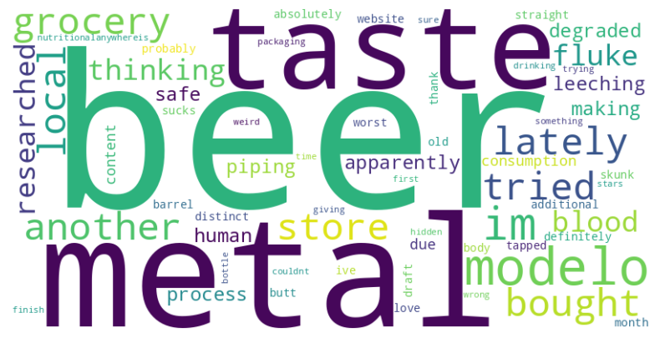
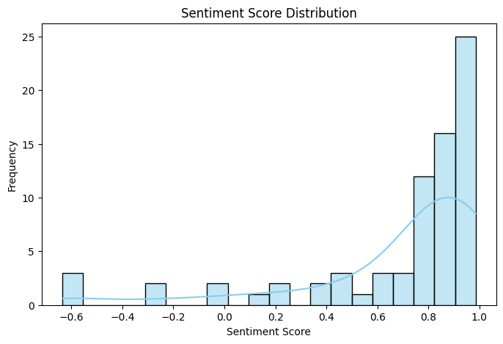
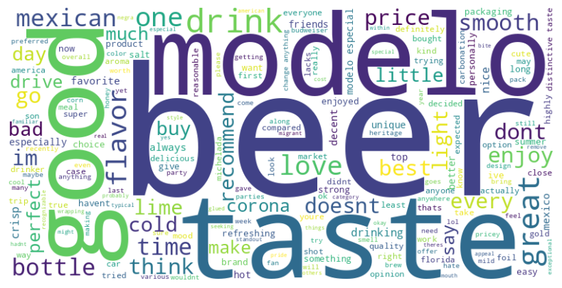
MODELO SENTIMENT ANALYSIS
Negative Reviews
Positive Reviews

Slide 7
SCALING UP THE PROJECT
Web scrape each description and star rating, automate to run periodically.
Run a sentiment analysis to see common keywords within their descriptions.
Implement K-Means Clustering to group similar products based on their textual descriptions, promotions, and reviews.
Run a regression model to find correlations between different features like image usage, descriptions, or keywords and the product ranking.
Run experiments with control and treatment group(s) once all different combinations of factors are determined.

